Slide 1


Coskun Erden
04/19/2023

Slide 2

Outline

Slide 3
Executive Summary
Methodologies: The project involved gathering SpaceX launch data via web scraping, identifying and addressing missing data, and performing exploratory analysis using SQL queries and data visualization (Folium and Plotly Dash). Predictive analysis was conducted with classification models, selecting the best performer based on accuracy.
Results: The analysis revealed a 67% success rate for SpaceX launches and identified correlations between launch success, payload mass, launch site, and orbit type. SQL queries provided key insights into launch sites and landing outcomes. The classification models achieved 83% accuracy with a 0.89 F1 score.
Overall Impact: This project demonstrates the power of data-driven insights in predicting SpaceX launch success and offers valuable information for optimizing future launches.

Slide 4
Introduction
"Will the first stage of a Falcon 9 rocket successfully land?" can have significant implications on the cost and feasibility of space launches. With the increasing interest and investment in the space industry, predicting the success of rocket launches has become an essential area of research.
In this context, the present project aims to create a machine learning pipeline to predict whether the first stage of a Falcon 9 rocket will land or not. The pipeline will be based on data from preceding labs, and its goal is to provide valuable insights that could be used by companies interested in bidding against SpaceX for rocket launches.
The project's objectives are to use machine learning algorithms to analyze the data, identify patterns, and create predictive models that can accurately forecast whether the first stage of a Falcon 9 rocket will land. By achieving these objectives, the project can help reduce costs, increase competition, and advance the space industry as a whole.

Slide 5

Section 1

Slide 6
Methodology
Data collection methodology:
The data collection process involved using Python to send a HTTP GET request to the Wikipedia page containing a table of Falcon 9 and Falcon Heavy launches. The HTML response was then converted into a BeautifulSoup object, allowing for easy extraction of relevant information. The column names were extracted from the table header, followed by the launch records from the table rows. The launch records were added to a launch_dict, which was then used to create a Pandas dataframe. Finally, the dataframe was saved to a CSV file. Overall, the process utilized web scraping techniques to extract and organize data from an online source.

Slide 7
Methodology
Performed data wrangling by
Identifying and calculating the percentage of missing values in each attribute: This step involves identifying the attributes that have missing data and calculating the percentage of missing values in each attribute.
Identifying which columns are numerical and categorical: This step involves categorizing each attribute/column based on the type of data it contains.
Determining the number of launches on each Space X launch facility: This step involves counting the number of launches that occurred at each launch facility of SpaceX.
Calculating the number and occurrence of each orbit: This step involves counting the number of times each orbit was used by SpaceX and calculating the frequency of each orbit's occurrence.
Calculating the number and occurrence of mission outcome per orbit type: This step involves calculating the frequency of each mission outcome for each orbit type.
Creating a landing outcome label from Outcome column: This step involves creating a new column that summarizes the landing outcome of each SpaceX mission.

Slide 8
Methodology
Perform exploratory data analysis (EDA) using visualization and SQL
Perform interactive visual analytics using Folium and Plotly Dash

Slide 9
Methodology
Perform predictive analysis using classification models by
Importing necessary libraries for data manipulation, analysis, and visualization.
Loading the data
Standardizing the data using
Split the data into training and testing sets
For each classification algorithm, creating an object and a GridSearchCV object
Fitting each model on the training data and selecting the best hyperparameters
Evaluating each model's performance on the test data using the accuracy score and plotting the confusion matrix
Comparing the accuracy and F1 score of each model and select the one that performed the best on the test data.

Slide 10
Data Collection
Web scraping to collect Falcon 9 historical launch records from a Wikipedia page
Send a HTTP GET request to https://en.wikipedia.org/wiki/List_of_Falcon_9_and_Falcon_Heavy_launches
Create a BeautifulSoup object from the HTML response
Extract the column names from the table header

Slide 11
Data Collection
Extract the launch records from the table rows
Create a Pandas dataframe using the launch_dict
Save the dataframe to a CSV file.

Slide 12
Data Collection – SpaceX API
Request the Falcon9 Launch HTML page by an HTTP GET method
Created a BeautifulSoup object from the HTML response
Extracted all column/variable names from the HTML table header
HTTP GET
BeautifulSoup object
names from the HTML table header

Slide 13
Data Collection – SpaceX API
Collected all relevant column names from the HTML table header
Fill up the column names with launch records extracted from table rows
column names from the HTML table header
Fill up the column names with launch records

Slide 14
Data Collection – Scraping
Created a data frame by parsing the launch HTML tables by
Creating an empty dictionary with keys from the extracted column names
And filling up the dictionary with launch records extracted from table rows.
parsing the launch HTML tables
Creating an empty dictionary
filling up the dictionary

Slide 15
Data Collection – SpaceX API
create a dataframe
export it to a CSV
dataframe
CSV
You can find the Jupyter notebook regarding the data collection process at this location.

Slide 16
Data Wrangling
Data were processed by:
Identifying and calculating the percentage of missing values in each attribute
Identifying which columns are numerical and categorical
Determining the number of launches on each Space X launch facility
Calculating the number and occurrence of each orbit
Calculating the number and occurrence of mission outcome per orbit type
Creating a landing outcome label from Outcome column
Input Data
Identify Missing Values
Identify Data Types
Analyze Launch Facilities
Analyze Orbits
Analyze Mission Outcomes by Orbit Type
Create a Landing Outcome Label
Output Clean Data

Slide 17
Data Wrangling
the success rate: 0.67
You can find the Jupyter notebook regarding the data wrangling process at this location.

Slide 18
EDA with Data Visualization
A scatter plot of FlightNumber vs. PayloadMass to see how they affect launch outcome
2. A scatter plot of Flight Number and Launch Site to see how they affect launch outcome
3. A scatter plot of Payload vs. Launch Site to see how they affect launch outcome
4. A bar graph of to see the relationship between success rate and each of orbit type

Slide 19
EDA with Data Visualization
5. A scatter plot of Orbit vs. Flight Number to see how they affect launch outcome.
A scatter plot of Orbit vs. Pay Load Mass to see how they affect launch outcome.
A line chart to see the launch success yearly trend
You can find the Jupyter notebook regarding the data visualization at this location

Slide 20
EDA with SQL
The SQL queries:
the names of the unique launch sites in the space mission
5 records where launch sites begin with the string 'CCA'
the total payload mass carried by boosters launched by NASA (CRS)
average payload mass carried by booster version F9 v1.1
the date when the first successful landing outcome in ground pad was achieved

Slide 21
EDA with SQL
the names of the boosters which have success in drone ship and have payload mass greater than 4000 but less than 6000
the total number of successful and failure mission outcomes
the names of the booster versions which have carried the maximum payload mass
the failed landing outcomes in drone ship, their booster versions, and launch site names for in year 2015
ranking of the count of landing outcomes (such as Failure (drone ship) or Success (ground pad)) between the date 2010-06-04 and 2017-03-20, in descending order

Slide 22
EDA with SQL
You can find the Jupyter notebook regarding the SQL queries at this location

Slide 23
Build an Interactive Map with Folium
Markers, circles, lines, and mouse positions were added to a folium map.
Markers were used to add the launch outcomes for each site, helping to identify the sites with high success rates. Marker clusters were also used to simplify the map containing many markers that had the same coordinate.
Circles were added to highlight specific areas, and text labels were added to provide additional information.

Slide 24
Build an Interactive Map with Folium
Lines were added to show the distances between the launch site and its proximities.
Finally, a MousePosition was added to allow users to get the coordinates of a point on the map when hovering over it with the mouse.
All of these objects were added to enhance the functionality and user experience of the map, making it more informative and easier to use.
You can find the Jupyter notebook regarding the interactive map with Folium at this location

Slide 25
Build a Dashboard with Plotly Dash
The dashboard includes a launch site dropdown menu and a range slider to interact with a pie chart and scatter plot.
The pie chart shows the success count for each launch site, while the scatter plot shows the correlation between payload and mission outcome.
The dashboard is designed to allow users to select specific launch sites and payload ranges to identify any visual patterns or correlations between payload and mission outcome.
The dropdown menu and range slider are added as input components, and callback functions are used to render the pie chart and scatter plot based on user selections.
You can find the Jupyter notebook regarding the Plotly Dash lab at this location

Slide 26
Predictive Analysis (Classification)
The flowchart for the predictive analysis is as follows:
Load Data -> Standardize Data ->
Split Data into Training and Testing Sets ->
Create Classification Object ->
Create GridSearchCV Object ->
Train Model with GridSearchCV ->
Select Best Hyperparameters ->
Evaluate Model on Test Data ->
Plot Confusion Matrix ->
Compare Model Performance ->
Select Best Performing Model.

Slide 27
Predictive Analysis (Classification)
Imported necessary libraries for data manipulation, analysis, and visualization.
Loaded the data using pandas read_csv() function.
Standardized the data using preprocessing.StandardScaler() method.
Split the data into training and testing sets using train_test_split() function with a test_size of 0.2 and random_state of 2.

Slide 28
Predictive Analysis (Classification)
For each classification algorithm, created an object and a GridSearchCV object with cv=10 to find the best parameters from a dictionary of hyperparameters.
Trained each model using the fit() method on the training data and selected the best hyperparameters using the best_params_ attribute and the best accuracy score using the best_score_ attribute.
Evaluated each model's performance on the test data using the score() method and plotted the confusion matrix using the plot_confusion_matrix() function.
Finally, compared the accuracy and F1 score of each model and selected the one that performed the best on the test data. All models had the same accuracy of 0.83 and F1 score of 0.8889.
You can find the Jupyter notebook regarding the Plotly Dash lab at this location

Slide 29

Section 2

Slide 30
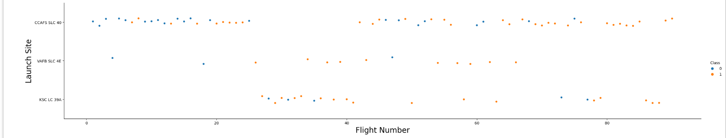
Flight Number vs. Launch Site
The success rate of launches has been increasing across all sites as the number of flight missions has increased. In other words, recent launches have been more successful.

Slide 31
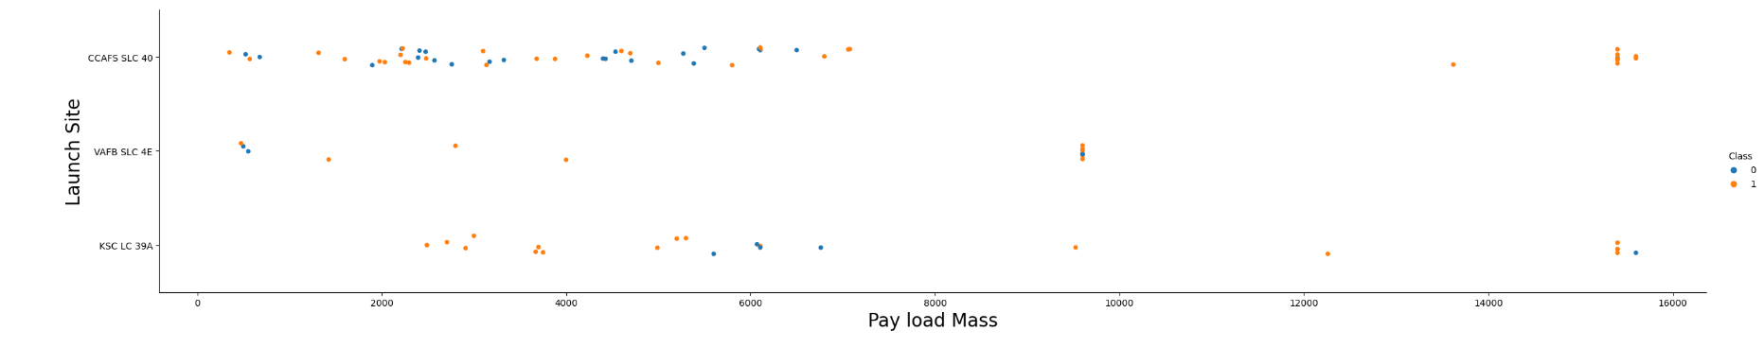
Payload vs. Launch Site
The scatter plot shows that the greater the payload mass, the higher the likelihood of a successful launch

Slide 32
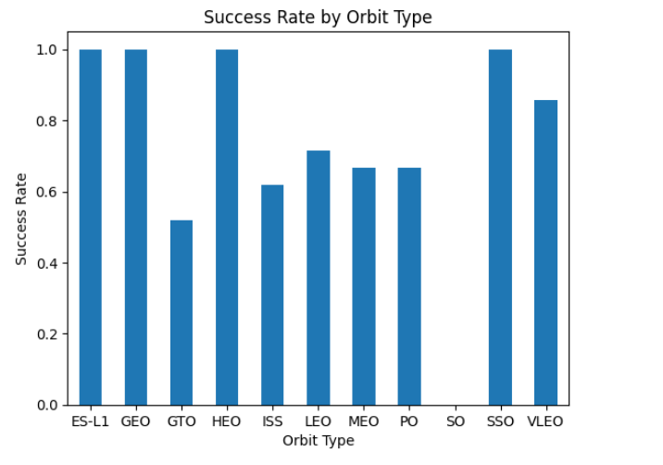
Success Rate vs. Orbit Type
Four of the orbits had a 100% success rate for all launches, while the remaining orbits had success rates ranging from 0.8 to 0.45, with the GTO orbit having the lowest success rate

Slide 33
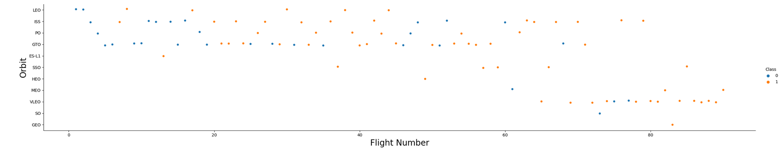
Flight Number vs. Orbit Type
The success rate for all orbits increases as the number of flights increases.

Slide 34
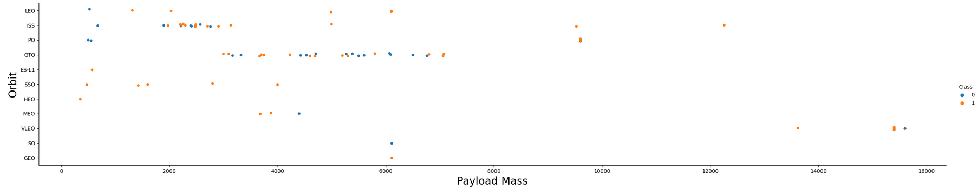
Payload vs. Orbit Type
There is no connection or correlation between Payload and the orbit

Slide 35
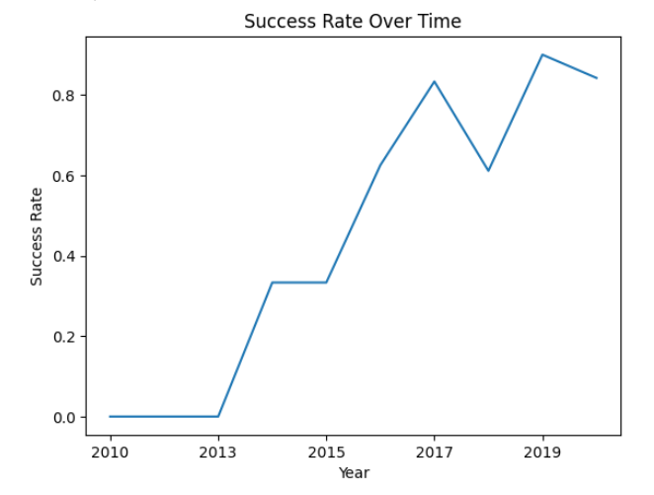
Launch Success Yearly Trend
As the years go by, the rate of successful launches goes up

Slide 36
All Launch Site Names
There are four launch sites:
CCAFS LC-40 , Cape Canaveral Air Force Station Launch Complex 40
VAFB SLC-4E, Vandenberg Air Force Base Space Launch Complex 4E
KSC LC-39A, Kennedy Space Center Launch Complex 39A
CCAFS SLC-40, Cape Canaveral Air Force Station Space Launch Complex 40

Slide 37
Launch Site Names Begin with 'CCA'
5 records where launch sites begin with `CCA` summarized below:
According to the first report, on 4th June 2010 at 6:45 pm, the launch took place from CCAFS LC-40, which is the Cape Canaveral Air Force Station Launch Complex 40. The booster used was F9 v1.0 B0003 and it carried a payload of Dragon Spacecraft Qualification Unit, weighing 0 kg, into a low Earth orbit (LEO). The customer for this mission was SpaceX, and it was deemed a success, except for the landing which failed due to issues with the parachute.
According to the second report, on 8th December 2010 at 3:43 pm, the launch took place from CCAFS LC-40, which is the Cape Canaveral Air Force Station Launch Complex 40. The booster used was F9 v1.0 B0004 and it carried a payload of Dragon demo flight C2 Unit, weighing 0 kg, into a low Earth orbit (LEO). The customer for this mission was NASA (COTS), and it was deemed a success, except for the landing which failed due to issues with the parachute.

Slide 38
Launch Site Names Begin with 'CCA'
According to the third report, on 22nd May 2012 at 7:44 am, the launch took place from CCAFS LC-40, which is the Cape Canaveral Air Force Station Launch Complex 40. The booster used was F9 v1.0 B0005 and it carried a payload of Dragon demo flight C2, weighing 525 kg, into a low Earth orbit (LEO). The customer for this mission was NASA (COTS), and it was deemed a success, except there was no attempt for landing.
According to the fourth report, on 8th October 2012 at 0:35 am, the launch took place from CCAFS LC-40, which is the Cape Canaveral Air Force Station Launch Complex 40. The booster used was F9 v1.0 B0006 and it carried a payload of SpaceX CRS-1 Unit, weighing 500 kg, into a low Earth orbit (LEO). The customer for this mission was NASA (CRS), and it was deemed a success, except there was no attempt for landing.

Slide 39
Launch Site Names Begin with 'CCA'
According to the fifth report, on 1th March 2013 at 3:10 pm, the launch took place from CCAFS LC-40, which is the Cape Canaveral Air Force Station Launch Complex 40. The booster used was F9 v1.0 B0007 and it carried a payload of SpaceX CRS-2 Unit, weighing 677 kg, into a low Earth orbit (LEO). The customer for this mission was NASA (CRS), and it was deemed a success, except there was no attempt for landing.

Slide 40
Total Payload Mass
The total payload mass carried by boosters from NASA is 45,596 kg kilograms

Slide 41
Average Payload Mass by F9 v1.1
The average payload mass carried by booster version F9 v1.1 is 2928.4 kg

Slide 42
First Successful Ground Landing Date
The date of the first successful landing outcome on ground pad is 01-05-2017

Slide 43
Successful Drone Ship Landing with Payload between 4000 and 6000
F9 FT B1022 (payload mass: 4696 kg)
F9 FT B1026 (payload mass: 4600 kg)
F9 FT B1021.2 (payload mass: 5300 kg)
F9 FT B1031.2 (payload mass: 5200 kg)
The list shows four Falcon 9 rocket flights: B1022, B1026, B1021.2, and B1031.2, which had successful drone ship landings with payloads between 4000 and 6000 kg. This demonstrates the reliability and versatility of the Falcon 9 rocket for various space missions.

Slide 44
Total Number of Successful and Failure Mission Outcomes
the total number of successful mission outcomes is 99
the total number of failure mission outcomes is 2

Slide 45
Boosters Carried Maximum Payload
F9 B5 B1048.4
F9 B5 B1049.4
F9 B5 B1051.3
F9 B5 B1056.4
F9 B5 B1048.5
F9 B5 B1051.4
F9 B5 B1049.5
F9 B5 B1060.2
F9 B5 B1058.3
F9 B5 B1051.6
F9 B5 B1060.3
F9 B5 B1049.7

Slide 46
2015 Launch Records
The table of the failed landing_outcomes in drone ship, their booster versions, and launch site names for in year 2015:
The table above shows two booster versions, F9 v1.1 B1012 and F9 v1.1 B1015, both launched from CCAFS LC-40 launch site.
Booster Versions | Launch Sites
F9 v1.1 B1012 | CCAFS LC-40
F9 v1.1 B1015 | CCAFS LC-40

Slide 47
Rank Landing Outcomes Between 2010-06-04 and 2017-03-20
20 Rockets: Success
11 Rockets: No attempt
8 Rockets: Success (drone ship)
6 Rockets: Success (ground pad)
4 Rockets: Failure (drone ship)
3 Rockets: Failure
3 Rockets: Controlled (ocean)
2 Rockets: Failure (parachute)
The query result above shows the landing outcomes of several rocket launches. The rockets are grouped by the type of landing outcome they had, such as success, failure, controlled landing, and no attempt. The number of rockets that fall into each group is also indicated in the list. For instance, there were 20 rockets that successfully landed, 11 rockets that did not attempt a landing, 8 rockets that successfully landed on a drone ship, and so on. This information can be useful in analyzing the success rate of rocket landings and identifying areas for improvement in future launches.

Slide 48

Section 3

Slide 49
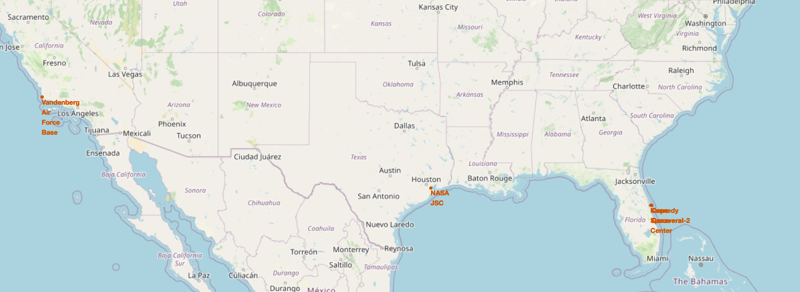
Map of Launch Sites
Names and locations of launch sites displayed on the map
There are three places where the launch sites are located
All launch sites are close to coastlines

Slide 50
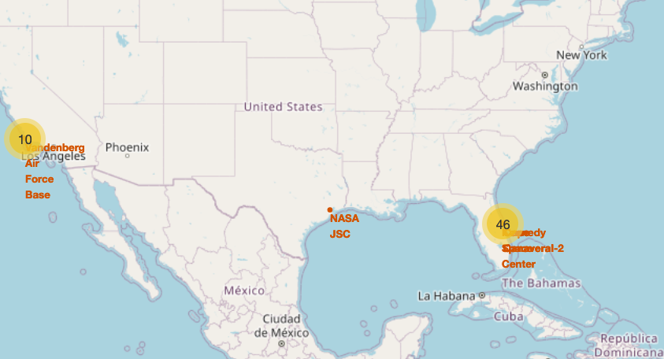
Map of the launch outcomes for each site
Name and the number of the launches in each launch site is presented
10 launches from Vandenberg ang 46 from Cape Canaveral

Slide 51
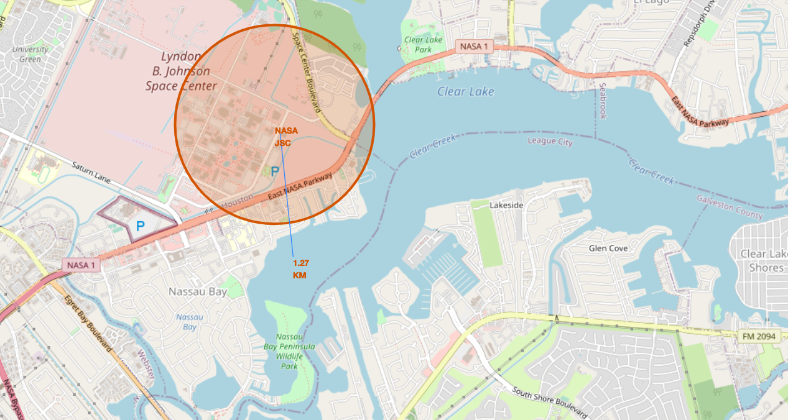
Distance to coastline
The distance from NASA Space center to the closest coastline is 1.27 miles

Slide 52

Section 4

Slide 53
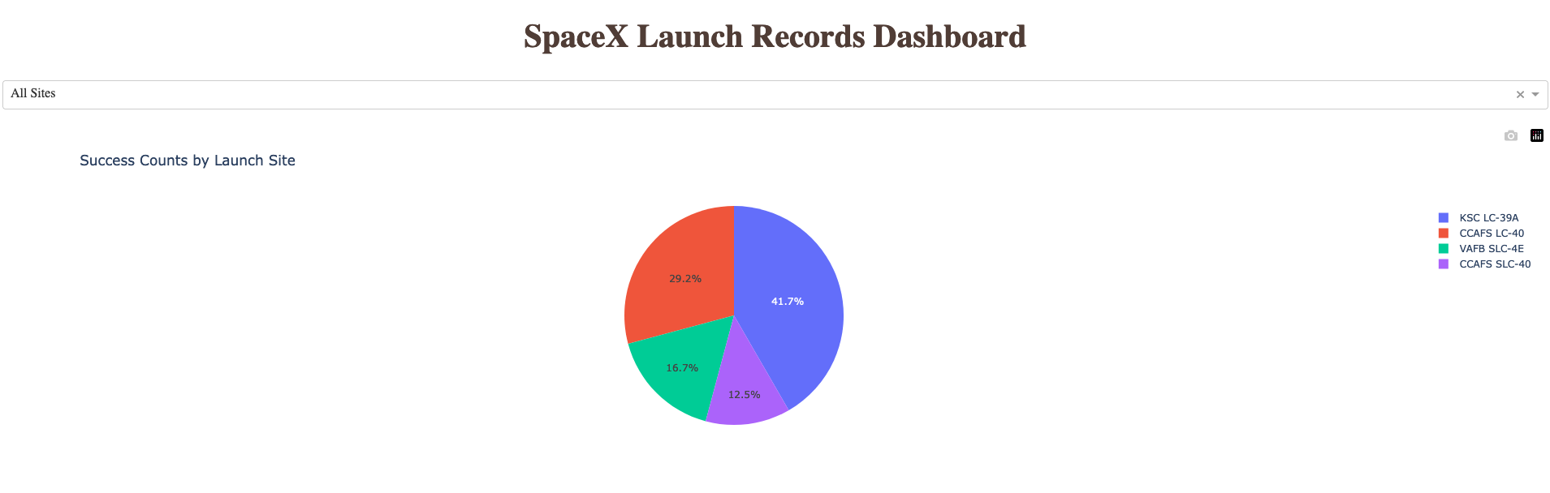
Launch success count for all sites
41.7 % of the successful launches from Kennedy Space Center
29.2 % of the successful launches from Cape Canaveral Air Force Station are
16.7 % of the successful launches from Vandenberg Air Force Base Space Launch Complex
12.5% of the successful launches from Cape Canaveral Air Force Station Space Launch Complex

Slide 54
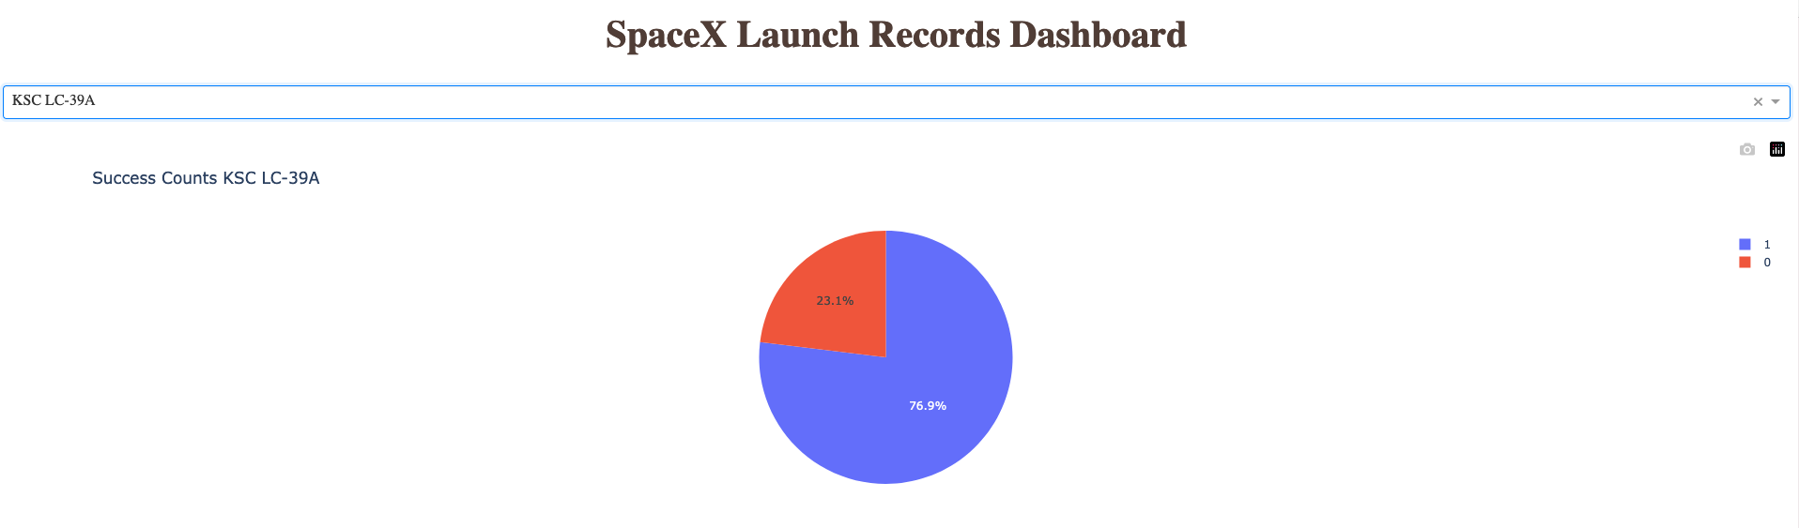
Launch site with highest launch success ratio
Kennedy Space Center has the highest success ratio with 76.9%

Slide 55
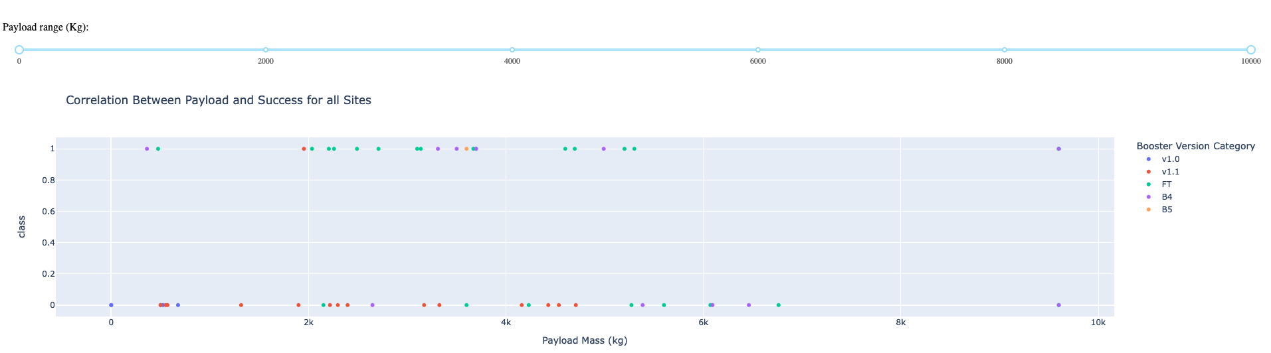
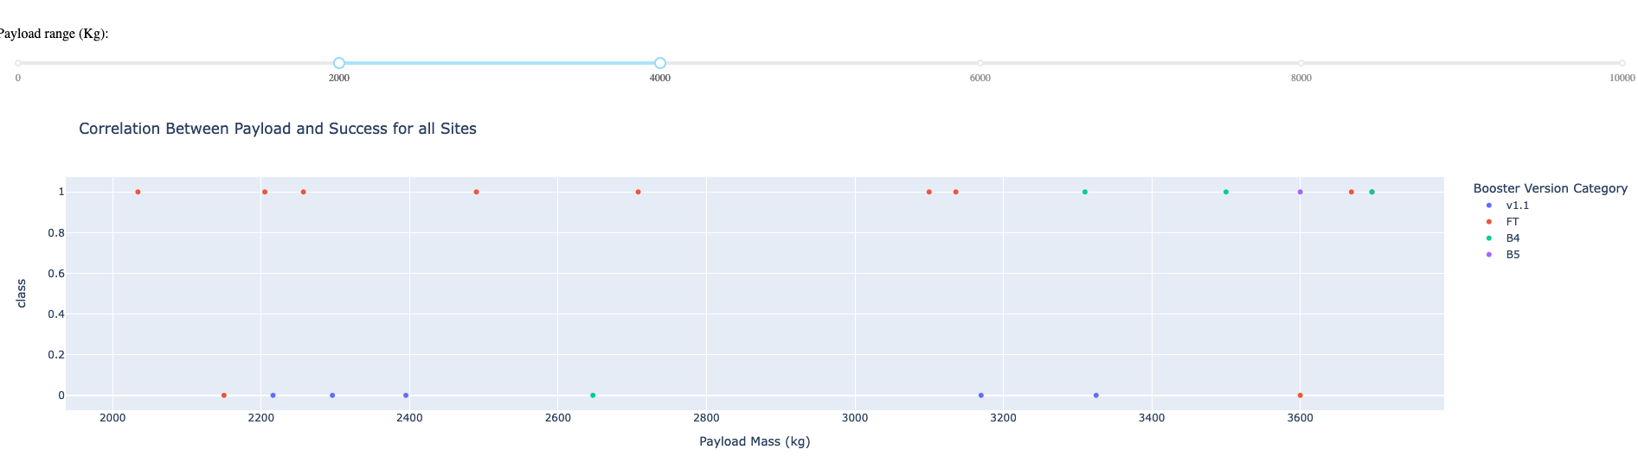
Payload vs. Launch Outcome scatter plot for all sites
Among the booster versions, FT has the largest success rate (considering all Payload range)
Payload range 2000 – 4000 has the largest success rate

Slide 56

Section 5

Slide 57
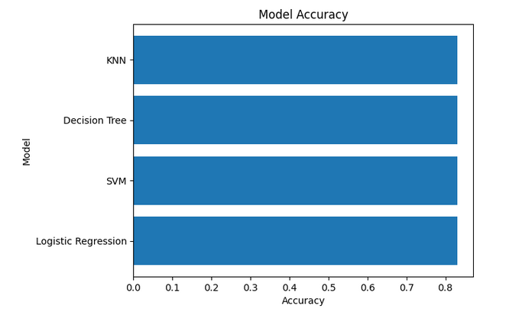
Classification Accuracy
All the models are returning the same accuracy:0.83

Slide 58
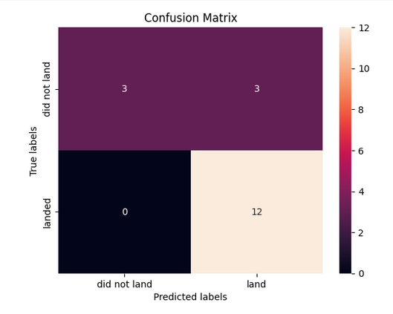
Confusion Matrix
# true positives = 12 precision = 0.8
# true negatives. = 3 recall = 1
# false positives = 3 specificity = 0.5
# false negatives = 0 F1 score = 0.8889

Slide 59
Conclusions
The project utilized web scraping techniques to extract and organize data from an online source.
Data wrangling was performed by identifying and calculating missing values, categorizing columns, determining launch counts, and calculating orbit and mission outcomes.
Exploratory data analysis was performed using visualization and SQL queries.
Predictive analysis was performed using classification models and evaluated using accuracy and F1 score.
The success rate of launches has been increasing across all sites.
There is a positive correlation between payload mass and launch success.
Four of the orbits had a 100% success rate for all launches.
The dashboard includes a launch site dropdown menu and a range slider to interact with a pie chart and scatter plot.
Kennedy Space Center has the highest success ratio with 76.9%.
Among the booster versions, FT has the largest success rate.
All models(Logistic regression, SVM, KNN, Decision Tree) are returning the same accuracy: 0.83.

Slide 60
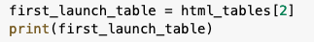
Appendix
Python code snippets,
SQL queries,
charts, Notebook outputs, or data sets that you may have created during this project

Slide 61
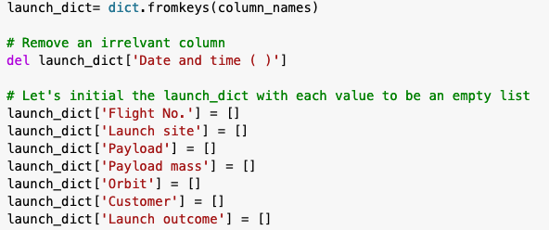
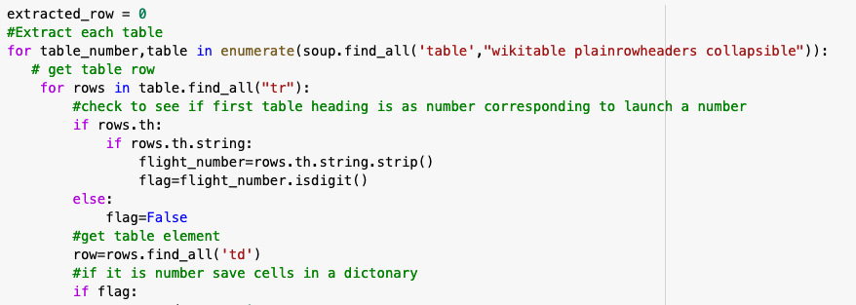
Appendix
Python code snippets,

Slide 62
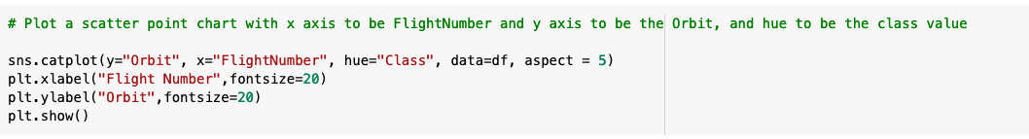
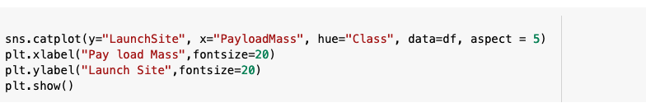
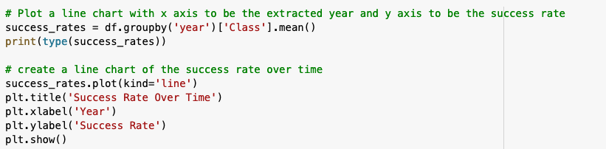
Appendix
Python code snippets,

Slide 63
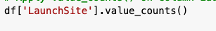
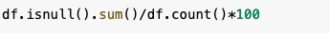
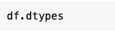
Appendix
Python code snippets,

Slide 64
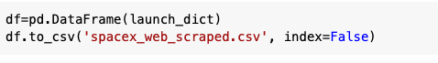
Appendix
Python code snippets,

Slide 65


